Slide 1


SOLAR POWER FORECASTING
USING MACHINE LEARNING

Slide 2

PRESENTED BY
SHAYAK CHAKRABORTY, 3RD YEAR, ECS
ROLL NUMBER- 501021010014
TOMOJIT GHOSH, 3RD YEAR, ECS
ROLL NUMBER- 501021010017
ARPAN DAS, 3RD YEAR, ECS
ROLL NUMBER- 501021010001
GURU NANAK INSTITUTE OF TECHNOLOGY
GUIDED BY
Ms. SUPARNA MAITY
ASSISTANT PROFESSOR, DEPT. OF ECS, GNIT

Slide 3
CONTENTS
INTRODUCTION
BACKGROUND
PREMILARY ANALYSIS
DATA PREPROCESSING AND MANIPULATION
TIME BASED TRAIN TEST SPLIT
FLOW CHART
CORRELATION HEATMAP
MODEL BUILDING
FEATURE ENGINEERING
HYPERPARAMETER OPTIMIZATION
PREDICTION
ACTUAL VS PREDICTED DATA PLOT
FUTURE SCOPE
CONCLUSION
REFERENCES

Slide 4
INTRODUCTION
Solar power is the conversion of energy from sunlight into electricity, either directly using photovoltaics (PV), or indirectly using concentrated solar power systems.
The main crucial and challenging issue in solar energy production is the intermittency of power generation due to weather conditions. In particular, a variation of the temperature and irradiance can have a profound impact on the quality of electric power production.
Hence, accurately forecasting the power output of PV modules in a short-term is of great importance for daily/hourly efficient management of power grid production, delivery, storage, as well as for decision-making on the energy markets.

Slide 5


BACKGROUND
Datasets:
Plant Generation Dataset
Weather Sensor dataset
We will predict solar power depends on 67699 observations and 7 attributes from the Plant Generation Dataset.
3260 observations and 6 attributes from the Weather Sensor dataset.
Attributes are given on Weather Sensor Dataset as
DATE_TIME - 15 minute timestamp
PLANT_ID - Common for entire file
SOURCE_KEY - Unique inverter id(total 22)
AMBIENT_TEMPERATURE - Ambient Temparature
at the plant
MODULE_TEMPERATURE - Temparature for the module
attaching to the sensor panel
IRRADIATION - Amount of irradiation for the 15 minutes
interval
Attributes are given on Plant Generation Dataset as
DATE_TIME - 15 minute timestamp
PLANT_ID - Common for entire file
SOURCE_KEY - Unique inverter id(total 22)
AC_POWER - Amount of ac power after
conversion form DC by inverter
DC_POWER - Amount of dc power generated
by the inverter
TOTAL_YIELD - Total yield for the inverter
DAILY_YIELD - Cumulative sum of power
generated on that day

Slide 6

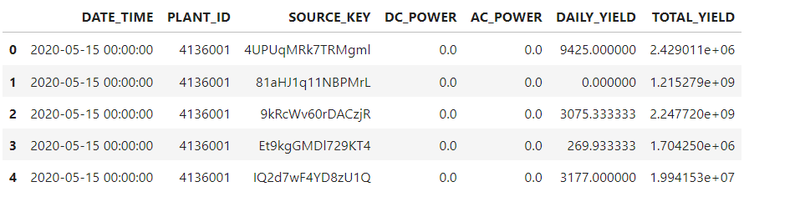
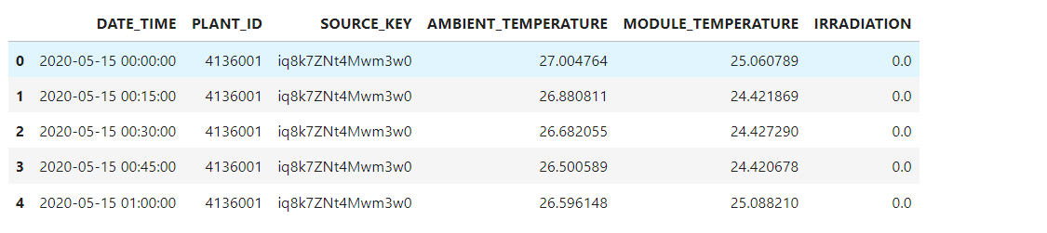
PRELIMINARY
ANALYSIS
It involves examining the initial rows of the dataset, commonly referred to as the data head.
It provides a quick overview of the data structure, allowing us to verify the column names, data types, and the presence of any obvious issues such as missing values or incorrect data types.
Examining the data head provides insight into the range of values and initial trends within the dataset.
DATA_HEAD OF THE BOTH DATASETS
Table 1: Plant Generation dataset’s head
Table 2: Weather Sensors dataset’s head

Slide 7
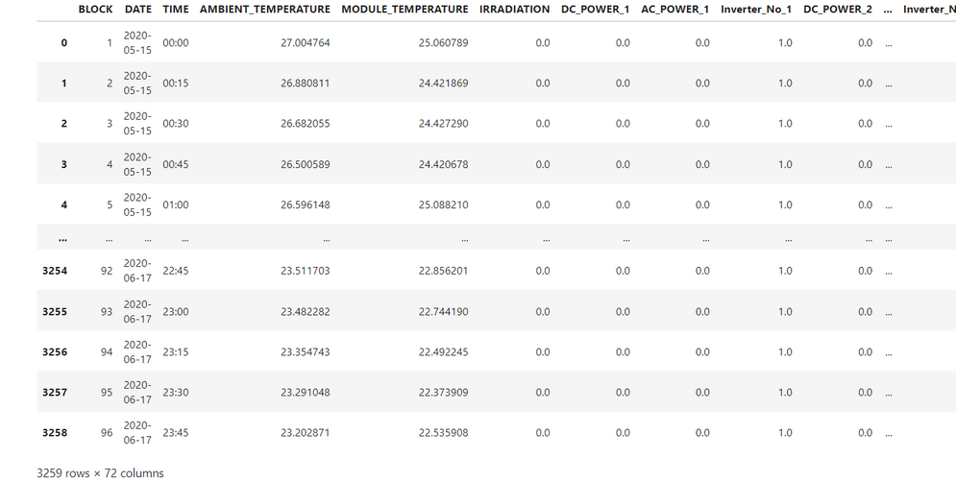
DATA PREPROCESSING AND
MANIPULATION
It involves cleaning the data by removing duplicates and handling missing values through imputation or deletion.
It includes transforming data by normalizing numerical features and encoding categorical variables.
Feature engineering is performed to create new variables from existing ones, providing additional insights for the model.
Lastly, data from multiple sources, such as different inverters, are merged to form a cohesive dataset.
Table 3: Merged data from both datasets

Slide 8
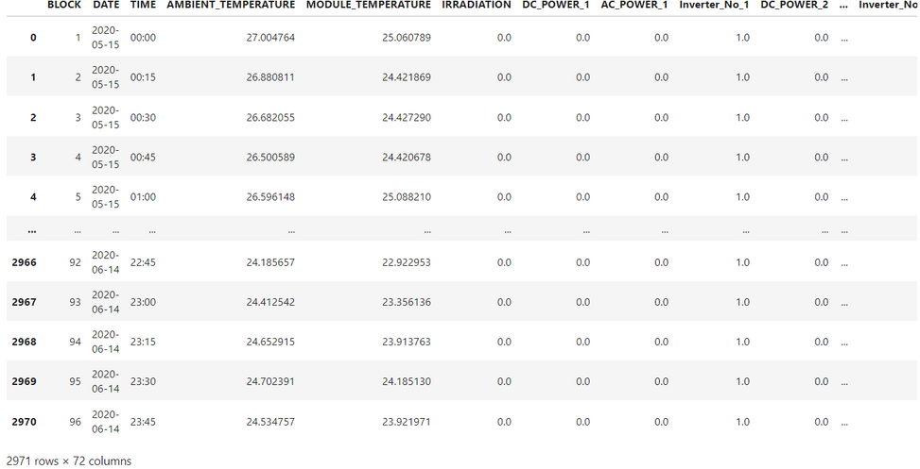
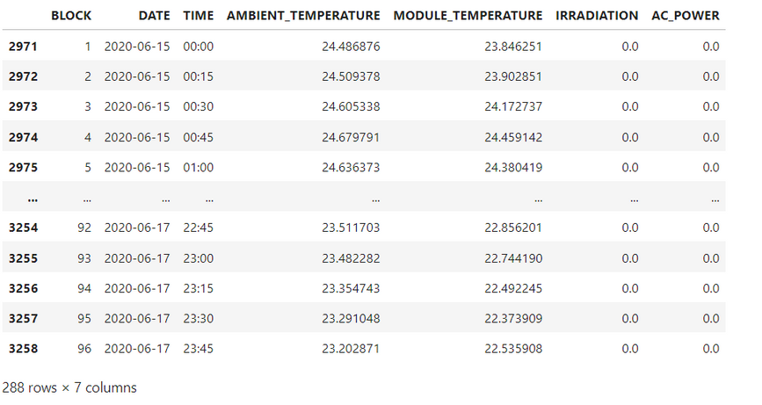
TRAIN DATA HEAD
TIME BASED
Table 4: df_train head data
TRAIN TEST SPLIT
By dividing the merged dataset into a training set and a testing set, typically in an 80/20 or 70/30 ratio.
It is ensured that the model is trained on one subset of data and validated on another.
It helps to assess the model’s performance and generalizability to new data. The training set is used to build and tune the model.
The testing set evaluates its accuracy and robustness, preventing overfitting and ensuring reliable predictions.
We have 2971 rows in train and 288 rows in test.
TEST DATA HEAD
Table 5: df_test head data

Slide 9

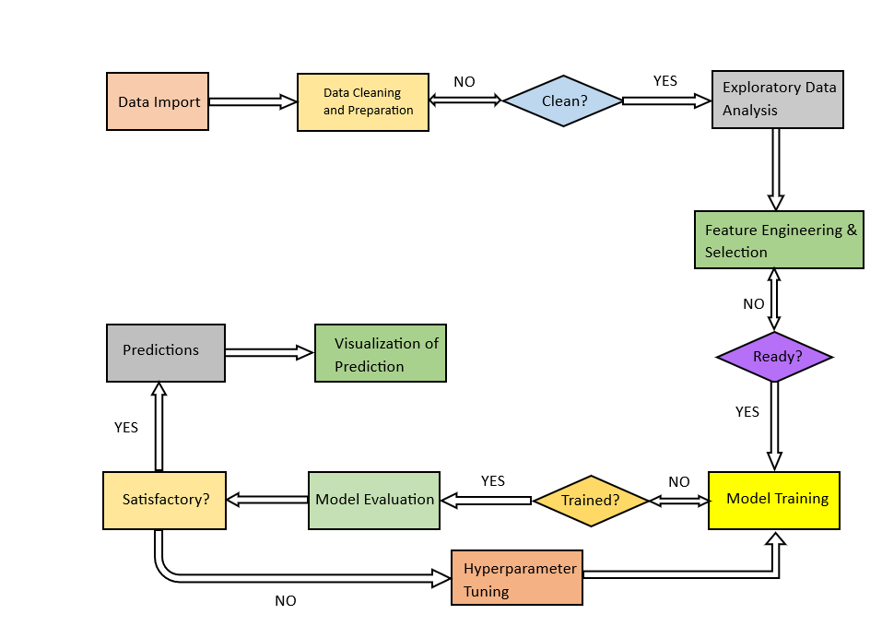
FLOW CHART
Fig 1: Flow Chart of the entire model

Slide 10
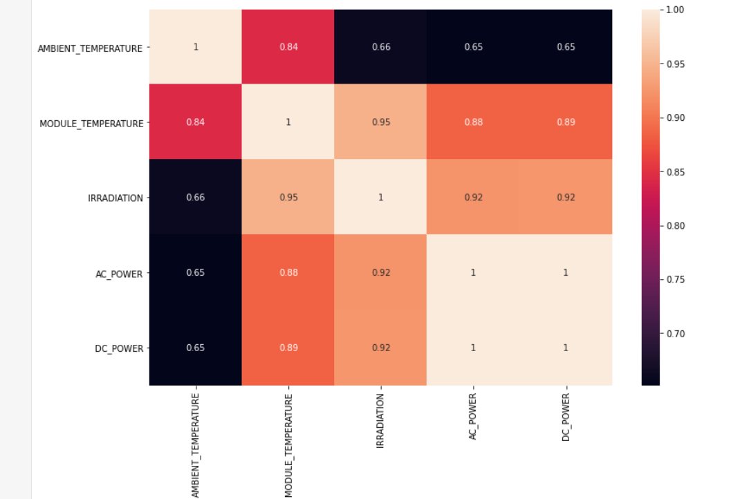
CORRELATION
HEATMAP
Ambient Temperature and Module Temperature: Strong positive correlation (0.84), indicating that as ambient temperature increases, module temperature also tends to increase.
Irradiation and Module Temperature: Very strong positive correlation (0.95), suggesting higher solar irradiation significantly increases module temperature.
Irradiation and AC/DC Power: Both have very strong positive correlations (0.92) with irradiation, implying that higher solar energy results in higher power generation.
AC Power and DC Power: Perfect correlation (1.0), showing that AC power and DC power are directly proportional and vary together perfectly.
Fig 2: Heatmap

Slide 11

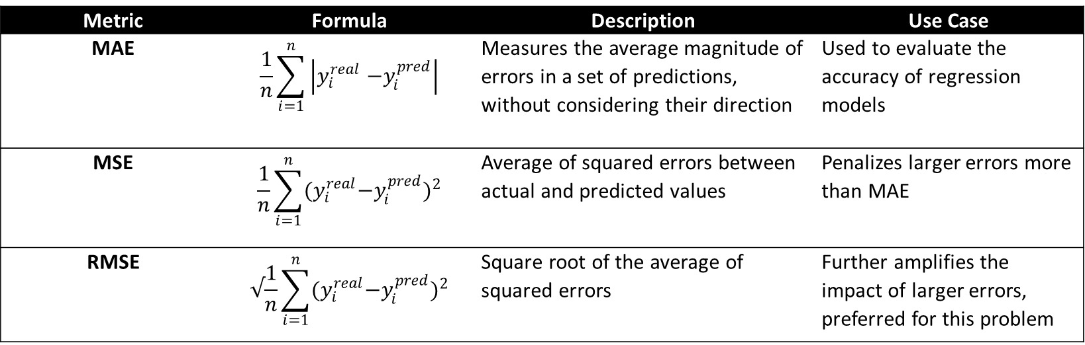
ALGORITHM SELECTION
Linear Regression: A simple yet effective method for predicting continuous variables, suitable for modeling the relationship between solar irradiation and power generation.
Decision Trees: Can capture non-linear relationships and interactions between variables.
Random Forests: An ensemble method that improves prediction accuracy by averaging multiple decision trees.
Support Vector Machines (SVM): Effective for regression tasks with high-dimensional data.
Neural Networks: Can model complex relationships and interactions between features, useful for capturing non-linear dependencies in the data.
MODEL
BUILDING
WHY CHOOSING RMSE OVER MAE AND MSE
Table 6: Differences between MAE, MSE and RMSE
Metric | Formula | Description | Use Case
MAE | $$\frac{1}{n}\sum_{i=1}^{n}{\left|y_{i}^{real}{−y}_{i}^{pred}\right|}$$ | Measures the average magnitude of errors in a set of predictions, without considering their direction | Used to evaluate the accuracy of regression models
MSE | $$\frac{1}{n}\sum_{i=1}^{n}{{{(y}_{i}^{real}−y_{i}^{pred})}^{2}}$$ | Average of squared errors between actual and predicted values | Penalizes larger errors more than MAE
RMSE | $$√\frac{1}{n}\sum_{i=1}^{n}{{{(y}_{i}^{real}−y_{i}^{pred})}^{2}}$$ | Square root of the average of squared errors | Further amplifies the impact of larger errors, preferred for this problem

Slide 12
MODEL TRAINING
Using Scikit-learn Pipelines: Utilizing Scikit-learn's pipeline functionality to streamline the training process. This allows for easy management and comparison of multiple models.
Regression Algorithms: Training seven different regression algorithms with default parameters, including a 3-layered Neural Network regressor.
Standardization: Before training, standardize the features to ensure that all variables are on the same scale.
MODEL
MODEL PERFORMANCE COMPARISON
BUILDING
Table 7: RMSE among different models
Regressor | RMSE (kW)
Linear Regression | 2.3738
Decision Tree Regressor | 2.3599
Random Forest Regressor | 1.7387
Ridge Regressor | 2.3774
Lasso Regressor | 2.7925
XG Boost Regressor | 1.8680
ANN Regressor | 3.3768
Random Forest Regressor has performed the best

Slide 13
FEATURE
ENGINEERING
Feature engineering involves creating, transforming, and selecting features to enhance model accuracy and predictive performance in machine learning.
Table 8: Comparison of Features before and after Engineering
Feature Set | Description | RMSE (kW)
Original Features | Initial set of raw features from the dataset (Ambient Temperature, Module Temperature, Irradiation, AC Power, DC Power) | 3.376760
Engineered Features | After applying transformation and selection (Time of Day [created from timestamp], Bins [based on Block no.], all numeric features) | 1.738688

Slide 14

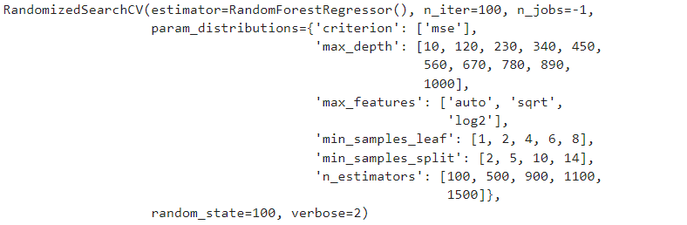
Hyperparameters are settings that need to be tuned to achieve the best possible performance from a model. For Random Forest Regressor, we focused on optimizing the following hyperparameters:
Number of Trees (n_estimators): Represents the number of trees in the forest.
Maximum Depth of Trees (max_depth): Controls the maximum depth of each tree.
Minimum Samples Split (min_samples_split): Defines the minimum number of samples required to split an internal node. Higher values prevent the model from learning overly specific patterns.
Minimum Samples Leaf (min_samples_leaf): The minimum number of samples required to be at a leaf node.
Maximum Features (max_features): Specifies the number of features to consider when looking for the best split.
Criterion: mse (Mean Squared Error): Measures the average of the squares of the errors or deviations, which is useful for regression tasks.
HYPERPARAMETER
OPTIMIZATION
Fig 3: Optimization using Randomized Search

Slide 15

PREDICTIONS
The Random Forest Regressor, optimized with the best hyperparameters, is used to predict the solar power output.
Predicted Values: Array of predicted solar power outputs for each instance in the test dataset.
Actual Values: Corresponding actual solar power outputs from the test dataset.
Performance Metric (Test RMSE): The RMSE on the test set is calculated to be 1.86830155234851 kW, indicating the model’s prediction accuracy.
SUMMARY
METRICS | VALUE (kW)
Test RMSE | 1.86830155234851

Slide 16
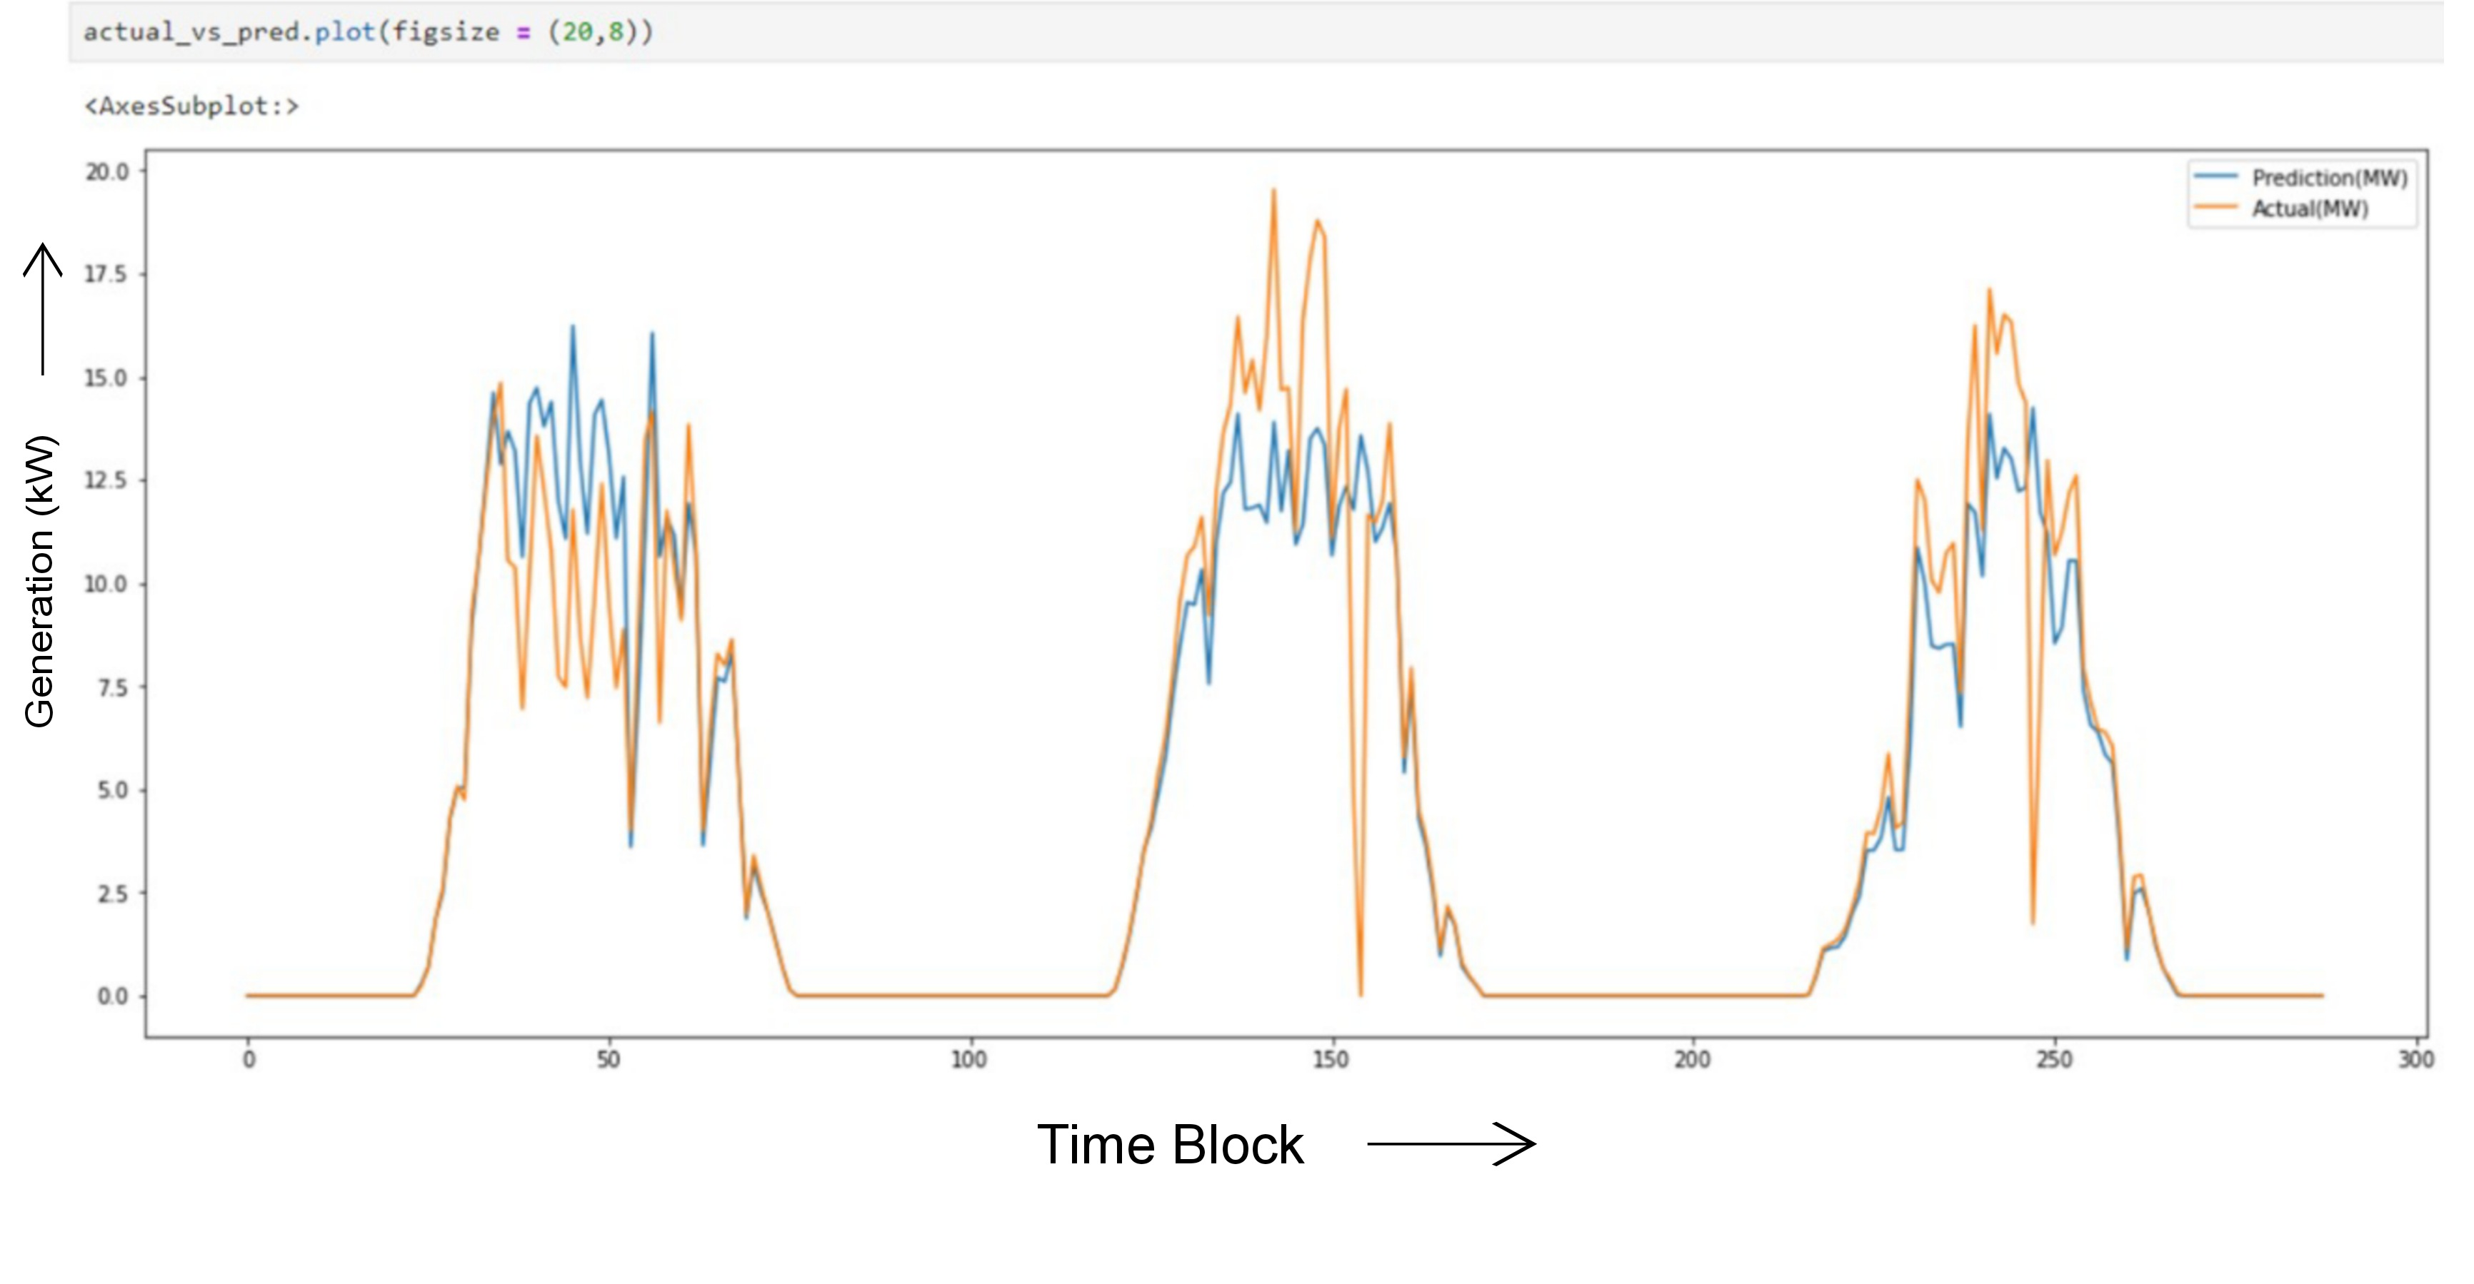
ACTUAL VS PREDICTED DATA PLOT
Fig 4: Actual vs Predicted Data Plot

Slide 17
Integrating of IoT devices can enhance the accuracy, efficiency, and real-time capabilities of our forecasting model.
Remote Monitoring and Control: IoT enables remote management, anomaly detection, and predictive maintenance of solar systems.
Enhanced Data Granularity: High-frequency data from IoT devices improves the model’s ability to capture short-term fluctuations.
Integration with Smart Grids: IoT-assisted forecasts help balance energy supply and demand dynamically within smart grids.
FUTURE
SCOPE

Slide 18
CONCLUSION
We split the data into training and test sets to ensure the model's performance could be validated on unseen data. Key preprocessing steps like imputation and outlier handling were meticulously applied to maintain data integrity. Through exploratory data analysis, we uncovered essential patterns and correlations that guided our model-building phase.
Various regression models were evaluated, with hyperparameter tuning performed via Grid Search Cross-Validation to optimize performance. The Random Forest Regressor emerged as the best model, achieving the lowest RMSE due to its robustness in capturing non-linear relationships and reducing overfitting.
Using Scikit-learn's pipeline functionality streamlined the training process and ensured consistency in model application. Predictions made on the test set demonstrated high accuracy, with the model's performance validated by a low RMSE. The optimized Random Forest model provided reliable solar power forecasts, crucial for balancing energy supply and demand.
This project highlights the effective use of machine learning in enhancing solar power utilization and offers a foundation for further improvements, such as integrating additional features or employing advanced algorithms to boost prediction accuracy.
The workflow and findings from this project contribute valuable insights into solar power forecasting, supporting sustainable energy management practices.

Slide 19
Books
[1] ”Solar Energy: The Physics and Engineering of Photovoltaic Conversion, Technologies and Systems"
Klaus Jäger, Olindo Isabella, Arno Smets, Rene van Swaaij, Miro Zeman
[2] ”Machine Learning and Data Science in the Power Generation Industry: Best Practices, Tools, and Case Studies"
Patrick Bangert
[3] ”Data Science for Supply Chain Forecasting"
Nicolas Vandeput
Journals
[1] ”A Comprehensive Review on Solar Power Forecasting"
U. A. Amam et al. , Renewable and Sustainable Energy Reviews, Journal of Machine Learning, volume 1, 2019
[2] “Data Preprocessing for Machine Learning in Solar Energy Forecasting"
T. Chen et al. , Renewable and Sustainable Energy Reviews, Journal of Machine Learning, volume 1, 2019
Datasets
https://www.kaggle.com/datasets/anikannal/solar-power-generation-data
REFERENCES

Slide 20
THANK YOU

